Slide 1
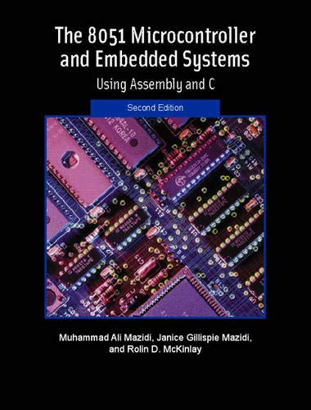
THE 8051
MICROCONTROLLER & Embedded Systems
Muhammad Ali Mazidi, Janice Mazidi
& Rolin McKinlay

Slide 2
JUMP, LOOP, AND CALL
INSTRUCTIONS
Chapter 3

Slide 3
Objectives
Upon completion of this chapter, you will be able to:
>> Code 8051 Assembly language instructions using loops
>> Code 8051 Assembly language conditional jump instructions
>> Explain conditions that determine each conditional jump instruction
>> Code long jump instructions for unconditional jumps
>> Code short jump instructions for unconditional short jumps
>> Calculate target addresses for jump instructions
>> Code 8051 subroutines
>> Describe precautions in using the stack in subroutines
>> Discuss crystal frequency versus machine cycle
>> Code 8051 programs to generate a time delay

Slide 4
Objectives
Discussing the control transfer instructions available in 8051 Assembly language,
Section 3.1, instructions used for looping, as well as instructions for conditional and unconditional jumps,
Section 3.2, CALL instructions and their uses,
Section 3.3, time delay subroutine.

Slide 5
Example 3-1: Looping in the 8051
Write a program to
(a) clear ACC, then
(b) add 3 to the accumulator ten times.
Solution:
;This program adds value 3 to the ACC ten times
MOV A,#0 ;A=0, clear ACC
MOV R2,#10 ;load counter R2=10
AGAIN: ADD A,#03 ;add 03 to ACC
DJNZ R2,AGAIN ;repeat until R2=0(10 times)
MOV R5,A ;save A in R5

Slide 6
Example 3-2
What is the maximum number of times that the loop in Example 3-1 can be repeated?
Solution:
Since R2 holds the count and R2 is an 8-bit register, it can hold a maximum of FFH (255 decimal); therefore, the loop can be repeated a maximum of 256 times.

Slide 7
Example 3-3: Loop Inside a Loop
Write a program to (a) load the accumulator with the value 55H, and (b) complement the ACC 700 times.
Solution:
Since 700 is larger than 255 (the maximum capacity of any register), we use two registers to hold the count. The following code shows how to use R2 and R3 for the count.
MOV A,#55H ;A=55H
MOV R3,#10 ;R3=10, the outer loop count
NEXT: MOV R2,#70 ;R2=70, the inner loop count
AGAIN: CPL A ;complement A register
DJNZ R2,AGAIN ;repeat it 70 times (inner loop)
DJNZ R3,NEXT
In this program, R2 is used to keep the inner loop count. In the instruction “DJNZ R2,AGAIN”, whenever R2 becomes 0 it falls through and “DJNZ R3,NEXT” is executed. This instruction forces the CPU to load R2 with the count 70 and the inner loop starts again. This process will continue until R3 becomes zero and the outer loop is finished.

Slide 8
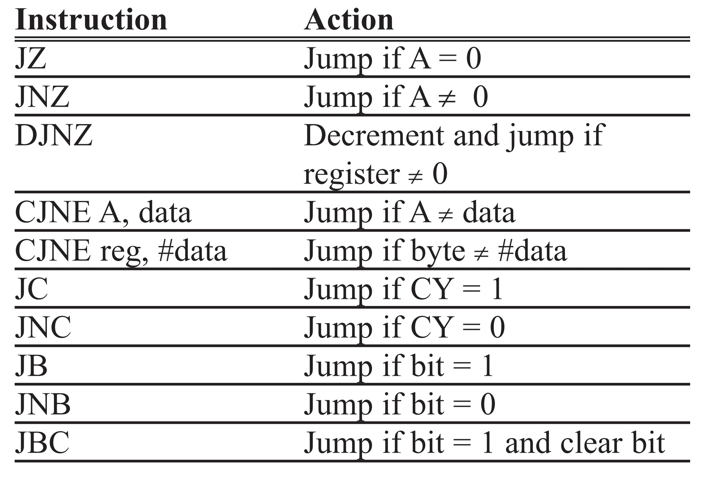
Table 3-1: 8051 Conditional Jump Instructions

Slide 9
Example 3-4
Write a program to determine if R5 contains the value 0. If so, put 55H in it.
Solution:
MOV A,R5 ;copy R5 to A
JNZ NEXT ;jump if A is not zero
MOV R5,#55H
NEXT: ...

Slide 10
Example 3-5
Find the sum of the values 79H, F5H, and E2H. Put the sum in registers R0 (low byte) and R5 (high byte).
Solution:
MOV A,#0 ;clear A(A=0)
MOV R5,A ;clear R5
ADD A,#79H ;A=0+79H=79H
JNC N_1 ;if no carry, add next number
INC R5 ;if CY=1, increment R5
N_1: ADD A,#0F5H ;A=79+F5=6E and CY=1
JNC N_2 ;jump if CY=0
INC R5 ;If CY=1 then increment R5(R5=1)
N_2: ADD A,#0E2H ;A=6E+E2=50 and CY=1
JNC OVER ;jump if CY=0
INC R5 ;if CY=1, increment 5
OVER: MOV R0,A ;Now R0=50H, and R5=02

Slide 11
Example 3-6
Using the following list file, verify the jump forward address calculation.
Line PC Opcode Mnemonic Operand
01 0000 ORG 0000
02 0000 7800 MOV R0,#0
03 0002 7455 MOV A,#55H
04 0004 6003 JZ NEXT
05 0006 08 INC R0
06 0007 04 AGAIN: INC A
07 0008 04 INC A
08 0009 2477 NEXT: ADD A,#77h
09 000B 5005 JNC OVER
10 000D E4 CLR A
11 000E F8 MOV R0,A
12 000F F9 MOV R1,A
13 0010 FA MOV R2,A
14 0011 FB MOV R3,A
15 0012 2B OVER: ADD A,R3
16 0013 50F2 JNC AGAIN
17 0015 80FE HERE: SJMP HERE
18 0017 END

Slide 12
Example 3-6
Solution:
First notice that the JZ and JNC instructions both jump forward. The target address for a forward jump is calculated by adding the PC of the following instruction to the second byte of the short jump instruction, which is called the relative address. In line 4 the instruction “JZ NEXT” has opcode of 60 and operand of 03 at the addresses of 0004 and 0005. The 03 is the relative address, relative to the address of the next instruction INC R0, which is 0006. By adding 0006 to 3, the target address of the label NEXT, which is 0009, is generated. In the same way for line 9, the “JNC OVER” instruction has opcode and operand of 50 and 05 where 50 is the opcode and 05 the relative address. Therefore, 05 is added to 000D, the address of instruction “CLR A”, giving 12H, the address of label OVER.

Slide 13
Example 3-7
Verify the calculation of backward jumps in Example 3-6.
Solution:
In that program list, “JNC AGAIN” has opcode 50 and relative address F2H. When the relative address of F2H is added to 15H, the address of the instruction below the jump, we have 15H + F2H = 07 (the carry is dropped). Notice that 07 is the address of label AGAIN. Look also at “SJMP HERE”, which has 80 and FE for the opcode and relative address, respectively. The PC of the following instruction, 0017H, is added to FEH, the relative address, to get 0015H, address of the HERE label (17H + FEH = 15H). Notice that FEH is -2 and 17H + (-2) = 15H. For further discussion of the addition of negative numbers, see Chapter 6.

Slide 14
Example 3-8
Write a program to toggle all the bits of port 1 by sending to it the values 55H and AAH continuously. Put a time delay in between each issuing of data to port 1. This program will be used to test the ports of the 8051 in the next chapter.
Solution:
ORG 0
BACK: MOV A,#55H ;load A with 55H
MOV P1,A ;send 55H to port 1
LCALL DELAY ;time delay
MOV A,#0AAH ;load A with AA (in hex)
MOV P1,A ;send AAH to port 1
LCALL DELAY
SJMP BACK ;keep doing this indefinitely
;—————— this is the delay subroutine
ORG 300H ;put time delay at address 300H
DELAY: MOV R5,#0FFH ;R5 = 255(FF in hex),the counter
AGAIN: DJNZ R5,AGAIN ;stay here until R5 becomes 0
RET ;return to caller (when R5 = 0)
END ;end of asm file

Slide 15
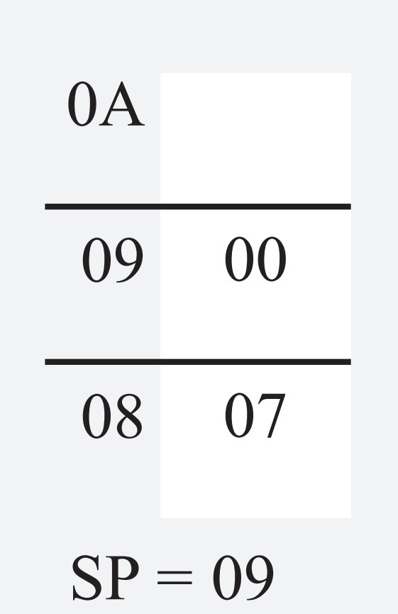
Example 3-9
Analyze the stack contents after the execution of the first LCALL in the following.
Solution:
001 0000 ORG 0
002 0000 7455 BACK: MOV A,#55H ;load A with 55H
003 0002 F590 MOV P1,A ;send 55H to port 1
004 0004 120300 LCALL DELAY ;time delay
005 0007 74AA MOV A,#0AAH ;load A with AAH
006 0009 F590 MOV P1,A ;send AAH to port 1
007 000B 120300 LCALL DELAY
008 000E 80F0 SJMP BACK ;keep doing this
009 0010
010 0010 ;————————this is the delay subroutine
011 0300 ORG 300H
012 0300 DELAY:
013 0300 7DFF MOV R5,#0FFH ;R5=255
014 0302 DDFE AGAIN: DJNZ R5,AGAIN ;stay here
015 0304 22 RET ;return to caller
016 0305 END ;end of asm file

Slide 16
Example 3-10
Analyze the stack for the first LCALL instruction in the following program.
01 0000 ORG 0
02 0000 7455 BACK: MOV A,#55H ;load A with 55H
03 0002 F590 MOV P1,A ;send 55H to port 1
04 0004 7C99 MOV R4,#99H
05 0006 7D67 MOV R5,#67H
06 0008 120300 LCALL DELAY ;time delay
07 000B 74AA MOV A,#0AAH ;load A with AA
08 000D F590 MOV P1,A ;send AAH to port 1
09 000F 120300 LCALL DELAY
10 0012 80EC SJMP BACK ;keep doing this
11 0014 ;————————this is the delay subroutine
12 0300 ORG 300H
13 0300 C004 DELAY: PUSH 4 ;PUSH R4
14 0302 C005 PUSH 5 ;PUSH R5
15 0304 7CFF MOV R4,#0FFH ;R4=FFH
16 0306 7DFF NEXT: MOV R5,#0FFH ;R5=255
17 0308 DDFE AGAIN: DJNZ R5,AGAIN
18 030A DCFA DJNZ R4,NEXT
19 030C D005 POP 5 ;POP into R5
20 030E D004 POP 4 ;POP into R4
21 0310 22 RET ;return to caller
22 0311 END ;end of asm file

Slide 17
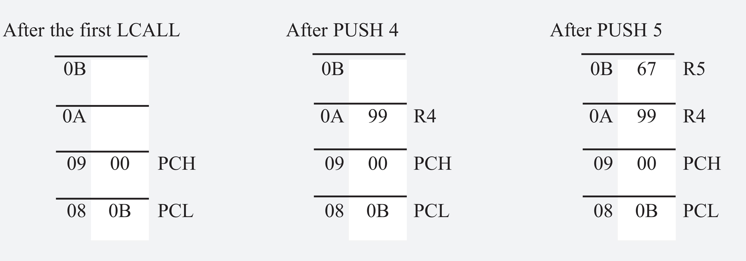
Example 3-10
Solution:
First notice that for the PUSH and POP instructions we must specify the direct address of the register being pushed or popped. Here is the stack frame.

Slide 18
;MAIN program calling subroutines
ORG 0
MAIN: LCALL SUBR_1
LCALL SUBR_2
LCALL SUBR_3
HERE: SJMP HERE
;————————end of MAIN
;
SUBR_1: ....
....
RET
;————————end of subroutine 1
;
SUBR_2: ....
....
RET
;————————end of subroutine 2
SUBR_3: ....
....
RET
;————————end of subroutine 3
END ;end of the asm file
Figure 3-1. 8051 Assembly Main Program That Calls Subroutines

Slide 19
Example 3-11
A developer is using the Atmel AT89C1051 microcontroller chip for a product. This chip has only 1K byte of on-chip flash ROM. Which instruction, LCALL or ACALL, is more useful in programming this chip?
Solution:
The ACALL instruction is more useful since it is a 2-byte instruction. It saves one byte each time the call instruction is used.

Slide 20
Example 3-12
Rewrite Example 3-8 as efficiently as you can.
Solution:
ORG 0
MOV A,#55H ;load A with 55H
BACK: MOV P1,A ;issue value in reg A to port 1
ACALL DELAY ;time delay
CPL A ;complement reg A
SJMP BACK ;keep doing this indefinitely
;————————this is the delay subroutine
DELAY:
MOV R5,#0FFH ;R5=255(FF in hex), the counter
AGAIN: DJNZ R5,AGAIN ;stay here until R5 becomes 0
RET ;return to caller
END ;end of asm file

Slide 21
Example 3-13
The following shows crystal frequency for three different 8051-based systems. Find the period of the machine cycle in each case.
(a) 11.0592 MHz (b) 16 MHz (c) 20 MHz
Solution:
(a) 11.0592 MHz/12 = 921.6 kHz; machine cycle is 1/921.6 kHz = 1.085 µs (microsecond)
(b) 16 MHz/12 = 1.333 MHz; machine cycle (MC) = 1/1.333 MHz = 0.75 µs
(c) 20 MHz/12 = 1.66 MHz; MC = 1/1.66 MHz = 0.60 µs

Slide 22
Example 3-14
For an 8051 system of 11.0592 MHz, find how long it takes to execute each of the following instructions.
(a)MOV R3,#55 (b)DEC R3 (c)DJNZ R2,target
(d)LJMP (e)SJMP (f)NOP (no operation) (g)MUL AB
Solution:
The machine cycle for a system of 11.0592 MHz is 1.085 µs as shown in Example 3-13. Table A-1 in Appendix A shows machine cycles for each of the above instructions. Therefore, we have:
Instruction Machine cycles Time to execute
(a) MOV R3,#55 1 1x1.085 µs = 1.085 µs
(b) DEC R3 1 1x1.085 µs = 1.085 µs
(c) DJNZ R2,target 2 2x1.085 µs = 2.17 µs
(d) LJMP 2 2x1.085 µs = 2.17 µs
(e) SJMP 2 2x1.085 µs = 2.17 µs
(f) NOP 1 1x1.085 µs = 1.085 µs
(g) MUL AB 4 4x1.085 µs = 4.34 µs

Slide 23
Example 3-15
Find the size of the delay in the following program, if the crystal frequency is 11.0592 MHz.
MOV A,#55H ;load A with 55H
AGAIN: MOV P1,A ;issue value in reg A to port 1
ACALL DELAY ;time delay
CPL A ;complement reg A
SJMP AGAIN ;keep doing this indefinitely
;----Time delay
DELAY: MOV R3,#200 ;load R3 with 200
HERE: DJNZ R3,HERE ;stay here until R3 become 0
RET ;return to caller
Solution:
From Table A-1 in Appendix A, we have the following machine cycles for each instruction of the DELAY subroutine.
Machine Cycle
DELAY: MOV R3,#200 1
HERE: DJNZ R3,HERE 2
RET 2
Therefore, we have a time delay of [(200 x 2) + 1 + 2] x 1.085 µs = 436.255 µs.

Slide 24
Example 3-16
For an 8051 system of 11.0592 MHz, find the time delay for the following subroutine:
Machine Cycle
DELAY: MOV R3,#250 1
HERE: NOP 1
NOP 1
NOP 1
NOP 1
DJNZ R3,HERE 2
RET 2

Slide 25
Example 3-16
Solution:
The time delay inside the HERE loop is [250(1 + 1 + 1 + 1 + 2)] x 1.085 µs = 1500 x 1.085 µs = 1627.5 µs. Adding the two instructions outside the loop we have 1627.5 µs + 3 x 1.085 µs = 1630.755 µs.
If machine cycle timing is critical to your system design, make sure that you check the manufacture’s data sheets for the device specification. For example, the DS89C430 has 3 machine cycles instead of 2 machine cycles for the RET instruction.

Slide 26
Example 3-17
For a machine cycle of 1.085 ms, find the time delay in the following subroutine.
DELAY: Machine Cycle
MOV R2,#200 1
AGAIN: MOV R3,#250 1
HERE: NOP 1
NOP 1
DJNZ R3,HERE 2
DJNZ R2,AGAIN 2
RET 2

Slide 27
Example 3-17
Solution:
For the HERE loop, we have (4 x 250) x1.085 µs = 1085 µs. The AGAIN loop repeats the HERE loop 200 times; therefore, we have 200 x 1085 µs = 217000, if we do not include the overhead. However, the instructions “MOV R3,#250” and “DJNZ R2,AGAIN” at the beginning and end of the AGAIN loop add (3 x 200 x 1.085 µs) = 651 µs to the time delay. As a result we have 217000 + 651 = 217651 µs = 217.651 milliseconds for total time delay associated with the above DELAY subroutine. Notice that in the case of a nested loop, as in all other time delay loops, the time is approximate since we have ignored the first and last instructions in the subroutine.

Slide 28
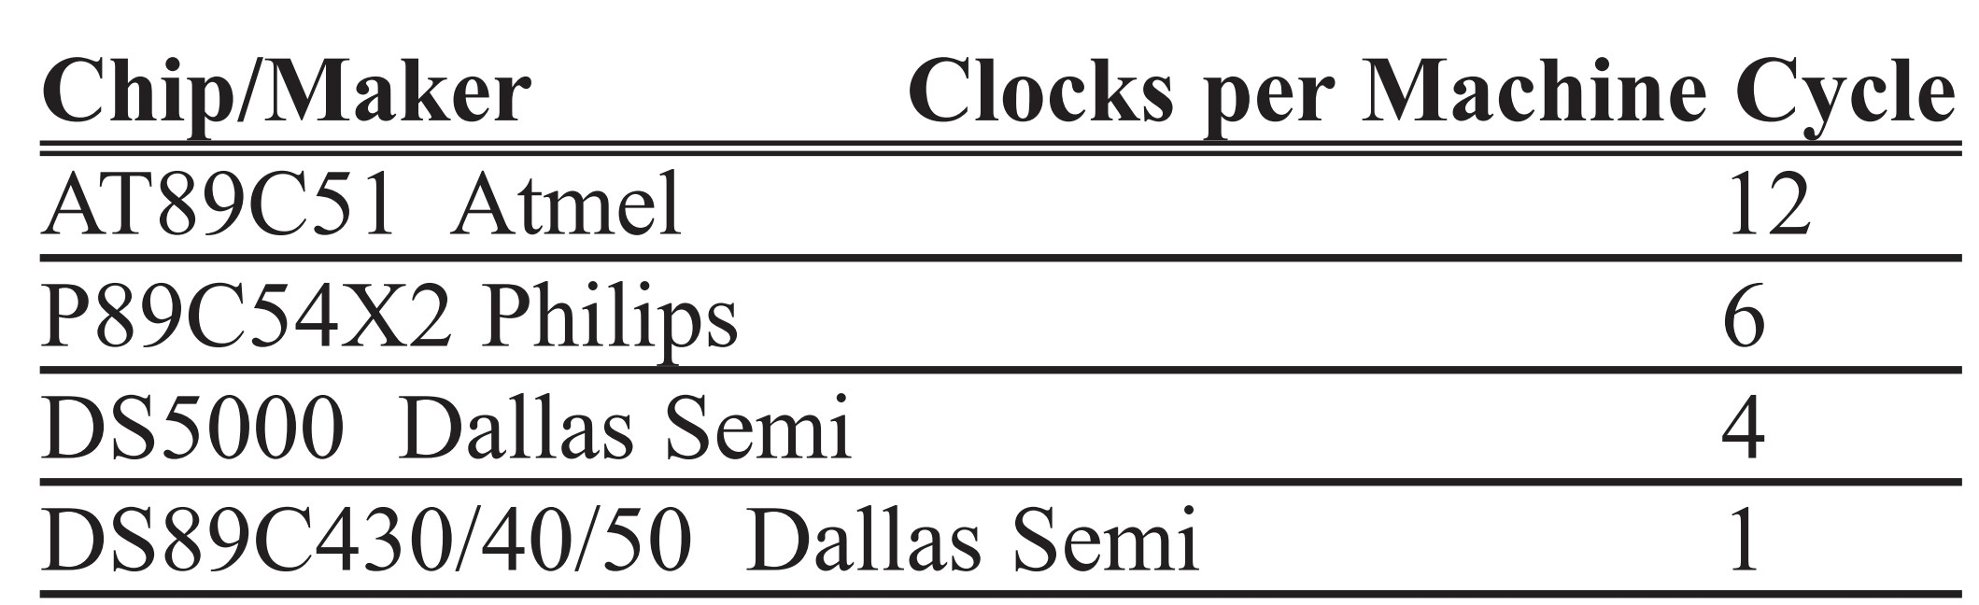
Table 3-2: Clocks per Machine Cycle (MC) for Various 8051 Versions

Slide 29
Example 3-18
From Table 3-2, find the period of the machine cycle (MC) in each case if XTAL = 11.0592 MHz, and discuss the impact on performance.
(a) AT89C51 (b) P89C54X2 (c) DS5000 (d) DS89C4x0
Solution:
(a) 11.0592 MHz/12 = 921.6 kHz; MC is 1/921.6 kHz = 1.085 µs (microsecond) = 1085 ns
(b) 11.0592 MHz/6 = 1.8432 MHz; MC is 1/1.8432 MHz = 0.5425 µs = 542 ns
(c) 11.0592 MHz/4 = 2.7648 MHz; MC is 1/2.7648 MHz = 0.36 µs = 360 ns
(d) 11.0592 MHz/1 = 11.0592 MHz; MC is 1/11.0592 MHz = 0.0904 µs = 90 ns

Slide 30
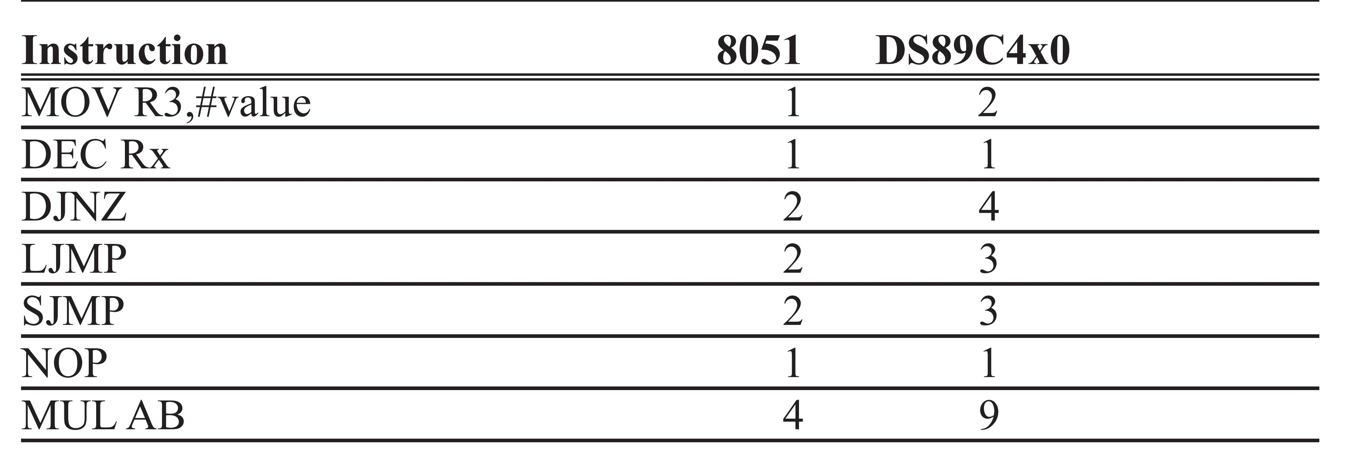
Table 3-3: Comparison of 8051 and DS89C4x0 Machine Cycles

Slide 31
Example 3-19
For an AT8051 and DS89C430/40/50 system of 11.0592 MHz, find how long it takes to execute each of the following instructions.
MOV R3,#55 (b) DEC R3 (c) DJNZ R2,target (d) LJMP (e) SJMP
(f) NOP (no operation) (g) MUL AB
Solution:
Refer to example 3-18 and table 3-3 .
Instruction AT8051 DS89C430/40/50
(a) MOV R3,#55 1x1085 ns = 1085 ns 2x90 ns = 180 ns
(b) DEC R3 1x1085 ns = 1085 ns 1x90 ns = 90 ns
(c) DJNZ R2,.. 2x1085 ns = 2170 ns 4x90 ns = 360 ns
(d) LJMP 2x1085 ns = 2170 ns 3x90 ns = 270 ns
(e) SJMP 2x1085 ns = 2170 ns 3x90 ns = 270 ns
(f) NOP 1x1085 ns = 1085 ns 1x90 ns = 90 ns
(g) MUL AB 4x1085 ns = 4340 ns 9x90 ns = 810 ns

Slide 32
Example 3-20
Find the time delay for the loop section of the following subroutine if it is run on a DS89C430 chip, assuming a crystal frequency of 11.0592 MHz.
DS89C430 Machine Cycle
DELAY: MOV R3,#250
HERE: NOP 1
NOP 1
NOP 1
NOP 1
DJNZ R3,HERE 4
RET
Solution:
The time delay inside the HERE loop is [250(1 + 1 + 1 + 1 + 4)] x 90 ns = 2000 x 90 ns = 180 µs. Comparing this with Example 3-16, we see DS89C4x0 is about 9 times faster. (1627 µs / 180 µs = 9)

Slide 33
Example 3-21
Write a program to toggle all the bits of P1 every 200 ms. Assume that the crystal frequency is 11.0592 MHz, and that the system is using the AT89C51.
Solution:
;Tested for AT89C51 of 11.0592 MHz.
MOV A,#55H
AGAIN: MOV P1,A
ACALL DELAY
CPL A
SJMP AGAIN
;----Time delay
DELAY: MOV R5,#2
HERE1: MOV R4,#180
HERE2: MOV R3,#255
HERE3: DJNZ R3,HERE3
DJNZ R4,HERE2
DJNZ R5,HERE1
RET
2 x 180 x 255 x2 MC x 1.085 µs = 199,206 µs

Slide 34
Example 3-22
Write a program to toggle all the bits of P1 every 200 ms. Assume crystal frequency is 11.0592 MHz and the system is using DS89C430/40/50.
Solution:
;Tested for DS89C430 of 11.0592 MHz.
MOV A,#55H
AGAIN: MOV P1,A
ACALL DELAY_200m
CPL A
SJMP AGAIN
;----Time delay
DELAY_200m:
MOV R5,#9
HERE1: MOV R4,#242
HERE2: MOV R3,#255
HERE3: DJNZ R3,HERE3
DJNZ R4,HERE2
DJNZ R5,HERE1
RET
Delay 9 x 242 x 255 x 4 MC x 90 ns = 199,940 µs

